Slide 1


Slide 2

Agenda
Review CactusCon
Tools
Questions?
Lab
https://blueteamlabs.online/home/investigation/32

Slide 3

Convention: CactusCon
Review
Favorite Talks

Slide 4


Slide 5

A Windows workstation was recently compromised, and evidence suggests it was an attack against internet-facing RDP, then Meterpreter was deployed to conduct 'Actions on Objectives'. Can you verify these findings?
Look for the Story
How does blank data fit into the bigger picture?

Slide 6
Tools
Powershell
Deep Blue
Event viewer

Slide 7
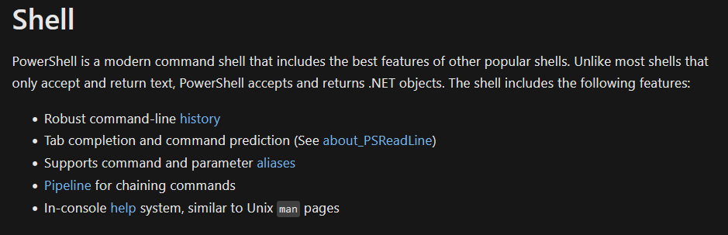
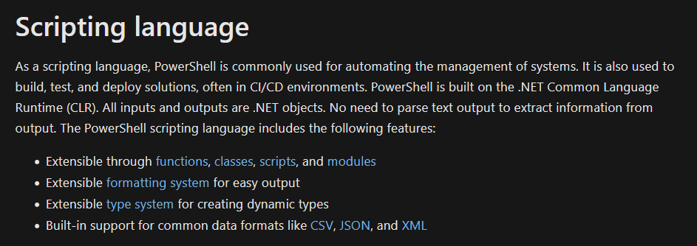
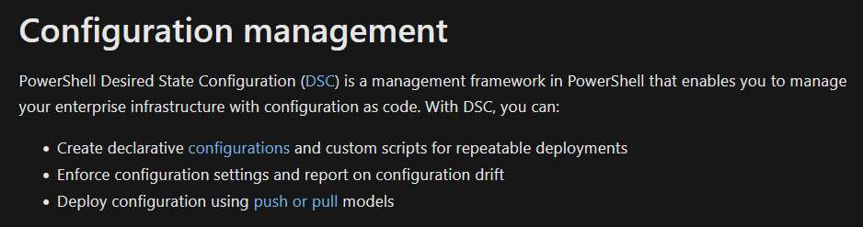
What is Powershell?

Slide 8
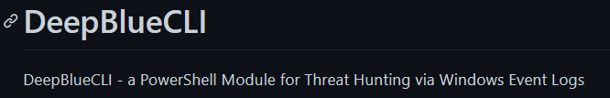
DeepBlueCLI
https://github.com/sans-blue-team/DeepBlueCLI
Looks for red flags in
Win Security
Wind System
Win Application
Win PowerShell
Sysmon
Detected Events
Sus account behavior
CLI/Sysmon/PowerShell auditing
Service Auditing
MimiKatz
Privilege escalation in windows (bad news)

Slide 9
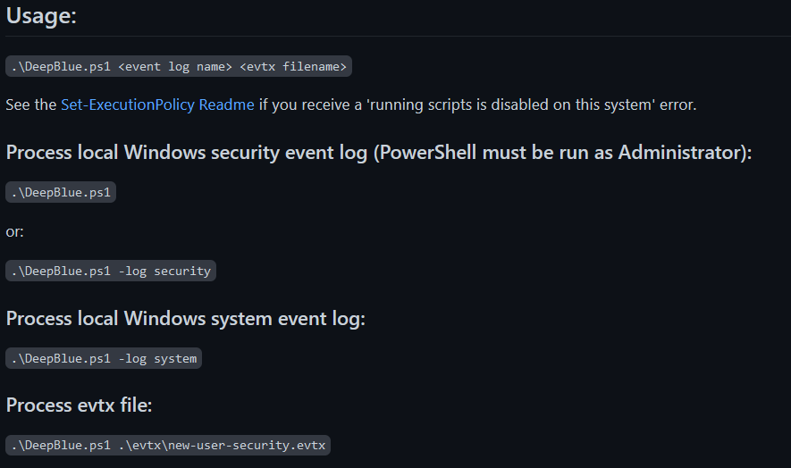
DeepBlueCLI
.\Deepblue.ps1 <event log name> | select-string –Pattern ‘findme’ | format-list

Slide 10
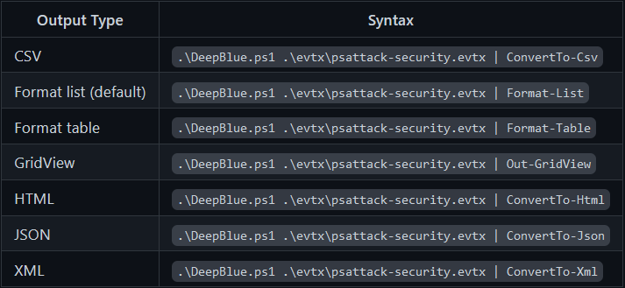
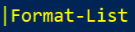
DeepBlueCLI

Slide 11
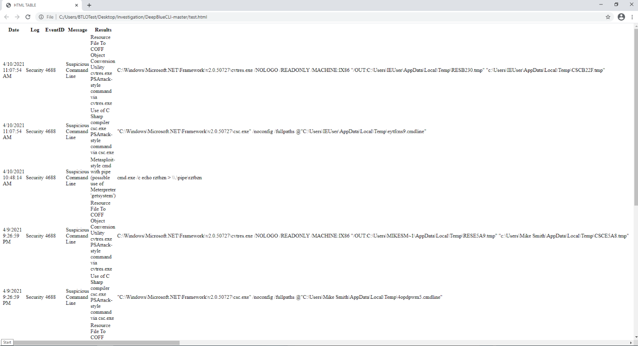

Slide 12
Event Viewer

Slide 13
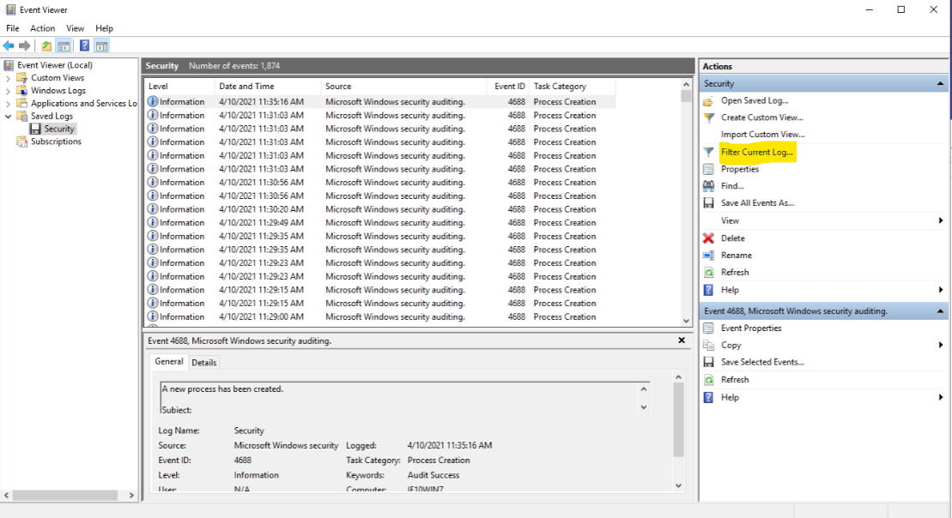

Slide 14
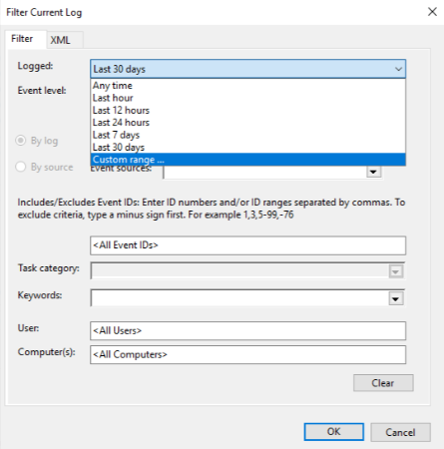

Slide 15
Lab @ https://blueteamlabs.online
Requires access to web browser
Under ‘Investigation’ tab, Search ‘Deep Blue’
https://blueteamlabs.online/home/investigation/32
Look for the Story
How does blank data fit into the bigger picture?

Slide 16
Question 1
Using DeepBlueCLI, investigate the recovered Security log (Security.evtx). Which user account ran GoogleUpdate.exe?

Slide 17
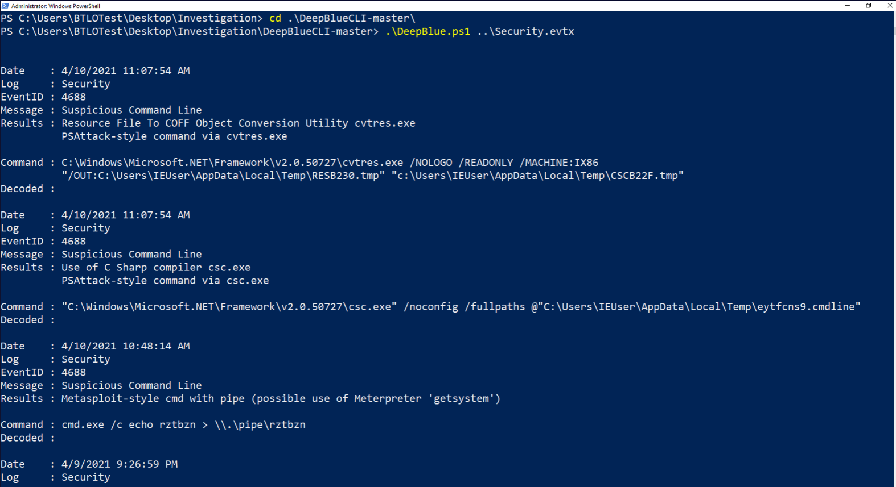

Slide 18
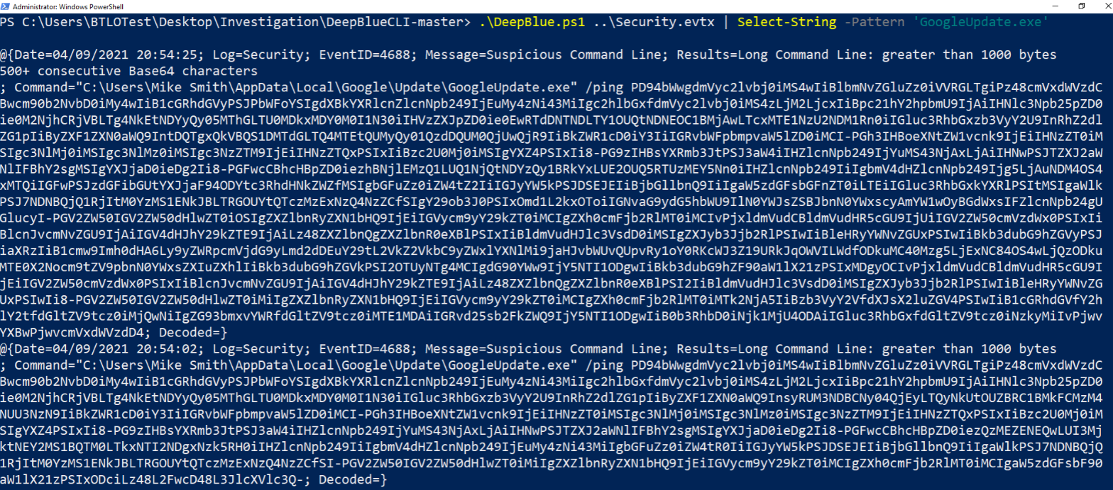

Slide 19
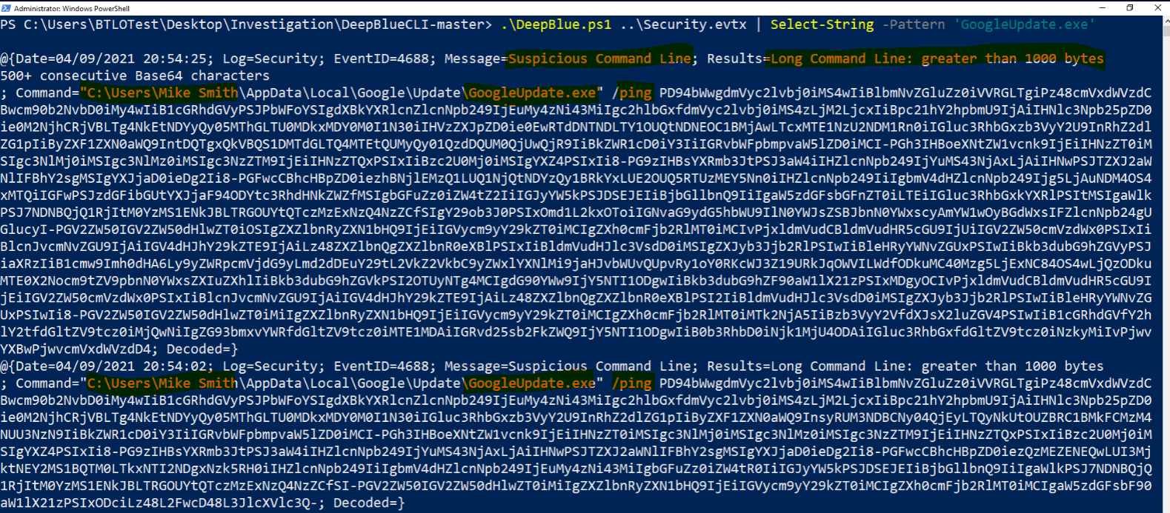

Slide 20
Question 2 --------------- Question 3
Using DeepBlueCLI investigate the recovered Security.evtx log. At what time is there likely evidence of Meterpreter activity?
-------------------------------------------------------
Using DeepBlueCLI investigate the recovered System.evtx log. What is the name of the suspicious service created?

Slide 21
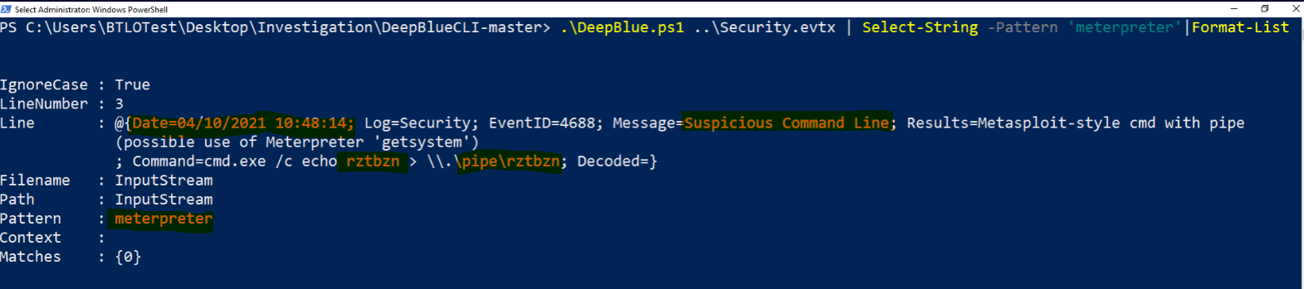

Slide 22
Question 4
Investigate the Security.evtx log in Event Viewer. Process creation is being audited (event ID 4688). Identify the malicious executable downloaded that was used to gain a Meterpreter reverse shell, between 10:30 and 10:50 AM on the 10th of April 2021.

Slide 23
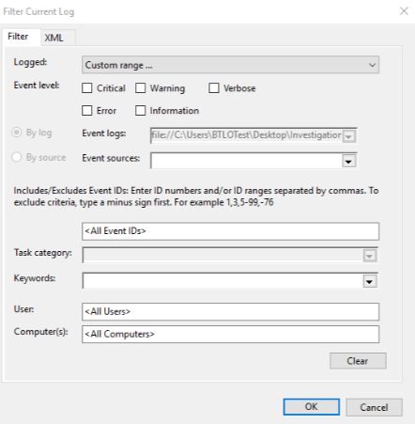
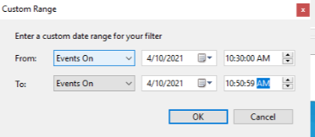

Slide 24
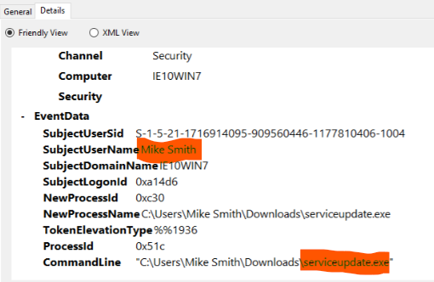

Slide 25
Question 5
It's also believed that an additional account was created to ensure persistence between 11:25 AM and 11:40 AM on the 10th April 2021. What was the command line used to create this account?

Slide 26
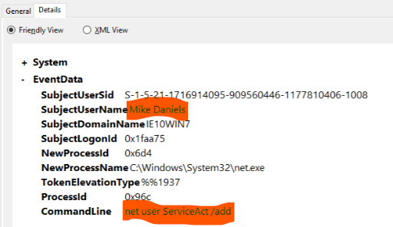

Slide 27
Question 6
What two local groups was this new account added to?

Slide 28
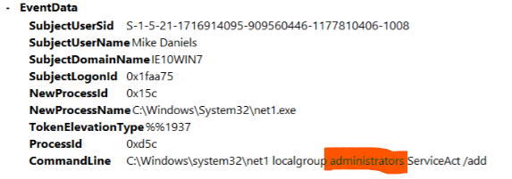
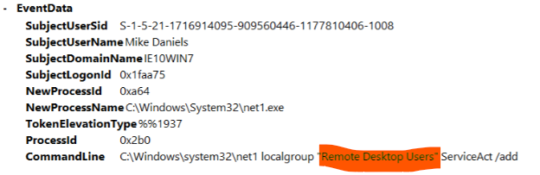

Slide 29

Questions?

